Slide 1
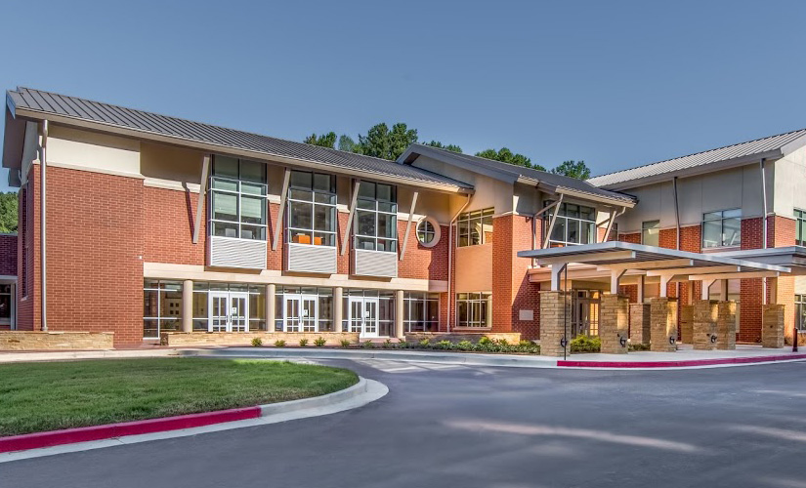
WELCOME TO 3rd GRADE AT HFES! 2018-2019
Ms. Michaela Rousseaux

Slide 2
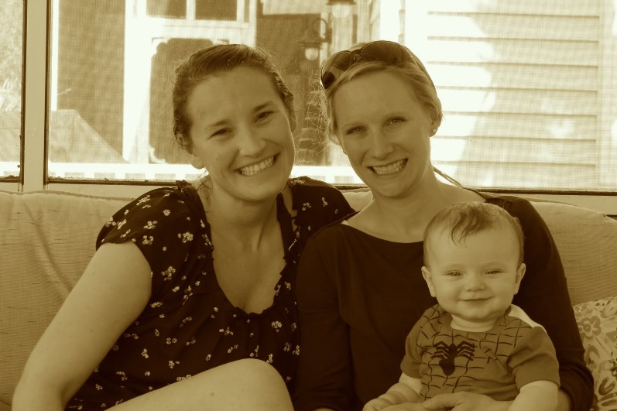
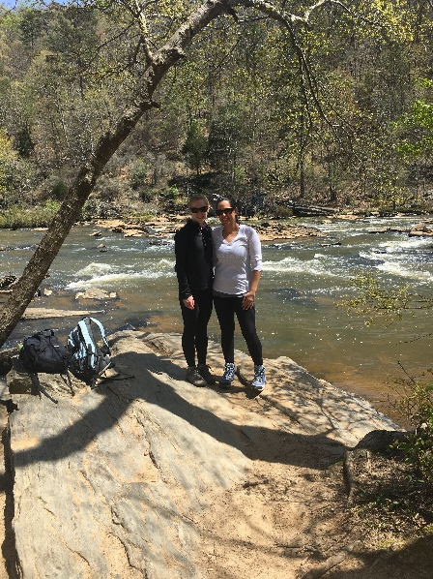
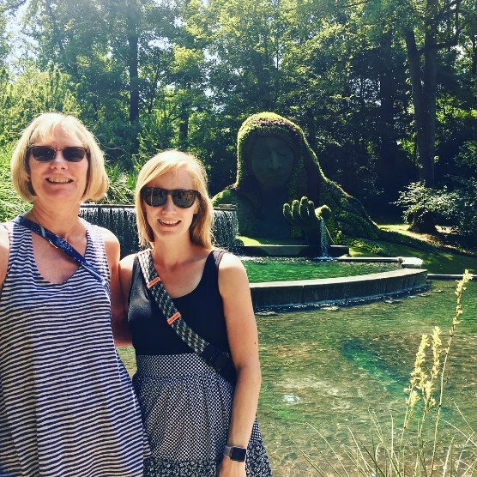
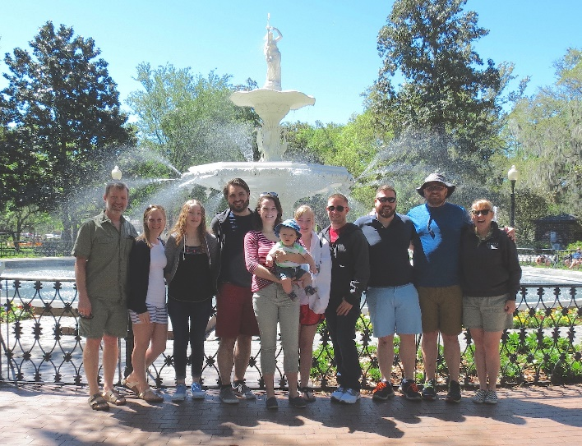
About Me
Originally from Boston, Massachusetts.
Undergraduate degree in Elementary Education and Geography from Salem State College in Salem, Massachusetts.
Masters of Education in Language in Literacy from Simmons College in Boston, Massachusetts.
7 years of teaching experience.
I enjoy hiking, playing tennis, traveling, reading, gardening, and spending time with family and friends.

Slide 3
Daily Schedule
7:10-7:40am Homeroom/ Morning Work
7:40-8:10am Team Time/Word Work
8:10-9:30am Math Inquiry
9:30-10:00am Recess
10:00-11:00am ELA Inquiry (Reading)
11:00-11:30am Lunch
11:30--12:35pm ELA Inquiry (Writing)
12:35--1:20pm *Specials
1:20-2:15pm Science/ Social Studies Inquiry
2:15pm Dismissal
*Specials:
Monday: Spanish
Tuesday: PE
Wednesday: Music
Thursday: Art
Friday: PE

Slide 4
Communicating with me
Email: rousseaux@fultonschools.org
rousseauxthird.weebly.com
By phone: 470-254-6195 (HFE Number)

Slide 5
How I will communicate with you
Monthly Newsletters
Thursday Folders
Agenda
Email
Weebly:
rousseauxthird.weebly.com

Slide 6
Attendance (School-wide)
Third Grade is a BIG year! We COMPLETELY understand that children get sick and families enjoy their time together. PLEASE try to limit your child’s non medical time away from school as much as you can. The homework will always be on the Weebly for them to work on and classwork will be worked on in class when they return. Thank you SO much for understanding! ☺
Please send a hand written note explaining your child’s absence to school the day your child returns!
Transportation changes must be sent in with your student the morning the change is made.
Information on absences and transportation are in the front of the agenda.

Slide 7
Organization for Classes
Folders and notebooks: EVERYTHING will stay in these.
LA/WRITING
MATH
SCIENCE
SOCIAL STUDIES
READING
Notebooks and folders will stay in their desk unless they come home for studying purposes.
Homework should always be written in agenda each day.
Red folder is used to transport papers back and fourth throughout the week.

Slide 8
Homework
It is the student’s responsibility to plan ahead in order to turn in homework on time.
Homework is written in the student’s agenda each day.
Homework is always due the following school day unless the “due date” is posted.
Reading should be nightly for at least 15 minutes, and record on reading log. Log can be found in My Reading Life folder.

Slide 9
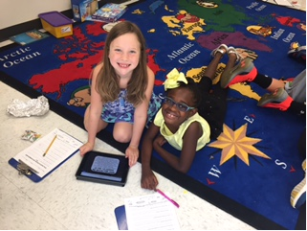
Parent Volunteers
We LOVE our parent volunteers!
Our homeroom’s Room Moms will be coordinating the volunteers. Please visit our class website to sign up for different volunteer opportunities throughout the year:
https://msrousseauxs3rdgradeclass201819.shutterfly.com
Our Room Moms are:
Jessica Jones- jessica30045@yahoo.com
Stacy Beard- stacythomasbeard@msn.com
Please make sure that if you are planning to come in and volunteer then you have completed the Online Volunteer Procedures.

Slide 10
Grading Policy
All grades will be posted on the (HAC) Home Access Center for you to view throughout the year. Grades 3-5 will be using a Standards Based Report Card.
Reports will go out four times during the school year (October, January, March, May)
If you have not received your ID or password please see Mrs. Julia with a valid ID to receive this information.
Grades:
Classwork/Projects 45%
Tests 30%
Quizzes 25%

Slide 11
Grading Policy Continued
Make Up Work: If your child is absent, they will make up their classwork on the day they return to school.
Late Work: Students will lose 2 points per day that the assignment is late- 10 point max (5 days late).
Not completed work: Will be entered in to HAC as an NHI (Not Handed In), this is the equivalent to a 50%. Students will be reminded of any missing assignments.

Slide 12
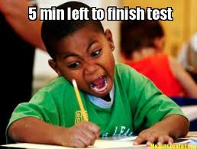
Testing
IOWA Testing is Oct. 22, 2018- Nov. 2, 2018
Milestone Testing is April 11th -25th, 2019
During these weeks students will not have any homework. Please allow them to get plenty of sleep, a good dinner, and a good breakfast!
Fastbridge-Universal Screener Fall, Winter, and Spring

Slide 13
Positive Behavior!
Whole Group: The students work for class soar point, once they fill a letter up, they will vote on a class reward.
Individual: The students each have a Star Card. The card has 10 stars. Students punch a star when they are caught showing amazing responsibility. When a card is completely full, students are allowed to pick a prize from the treasure box.
PBIS- Eagle Points
Notes:
The system that we are using in 3rd grade is based on positive reinforcement and is linked to our school wide behavior management system using the behavior matrix. The behavior matrix divides the school into setting (classroom, hallway, bathroom, cafeteria, etc). Each setting displays the expectations of the students.

Slide 14
Curriculum
GA Standards of Excellence
www.georgiastandards.org
Small Group Instruction- I will pull a small group of students and work on a needed skill, while other students work on hands-on learning centers/activities geared toward standards and skills they are working to master.
Math Groups
Reading Groups
Writing Groups
Differentiation-Small group instruction and one-on-one student conferences.
Student conferences- I meet with student, we have a discussion of what they are working on as a reader or writer. I teach them a skill they need to work on. I follow up with student at our next conference.
Writing Genres- Narrative, Opinion and Information
Balanced Literacy

Slide 15
IB PYP
International Baccalaureate Primary Years Programme
6 transdisciplinary themes
Learner Profile
IB Attitudes
Spanish for 1st –5th
Cookies for Character
International Inquirer
Service Projects

Slide 16
International Baccalaureate (IB)
Attitudes
Appreciation
Commitment
Confidence
Cooperation
Creativity
Curiosity
Empathy
Enthusiasm
Independence
Integrity
Respect
Tolerance
Learner Profiles
Caring
Communicator
Inquirer
Knowledgeable
Open-minded
Principled
Reflective
Risk-taker
Thinker
Balanced

Slide 17
I.B. Continued
Globally minded teaching
Transdisciplinary Themes
Who We Are
Where We Are In Place and Time
How We Express Ourselves
How the World Works
How WE Organize Ourselves
Sharing The Planet

Slide 18
Digital Citizenship

Slide 19
Math
Rigor
Explain what you are thinking. Using words, pictures, numbers, equations, etc.
Depth of Knowledge
Example: Allowing the students to try to figure it out first before coming together to discuss what they learned.
The units are multiple concepts that build upon each other.
We do use IReady Math.

Slide 20
Why Reader’s & Writer’s Workshop?
“…students become powerful readers and writers who read and write for real reasons - to advocate for themselves and others, to deepen their own and others’ knowledge, to illuminate the lives they live and the world they are a part of.”
Our work aims to prepare kids for any reading and writing task they will face or set themselves, to turn them into life-long, confident readers and writers who display agency and independence in their future endeavors.
The Reading & Writing Project
Teacher’s College, Columbia University

Slide 21
What is Reader’s Workshop?
Reader’s workshop is a literature based program where students read and respond to meaningful text while focusing on a reading skill. Students get to choose what they read and how they implement the skill
What does it look like?
I deliver a short mini-lesson on a comprehension skill. Then, students practice the skill during independent reading time. They focus on the skill while reading and responding to their text to help them make a connection with the concept taught.

Slide 22
What is Writer’s Workshop?
Writer’s workshop is an environment where students can acquire the skills and confidence to see themselves as writers. Student’s are put in charge and are actively involved in creating their own texts. The writing workshop puts students on the spot and makes them responsible for their writing.
What does it look like?
I deliver instruction on a specific writing technique during a brief mini-lesson. Then, students practice the technique during independent writing time. We write every day and student’s determine the subject they write about within the genre’s.

Slide 24
Science
There are six units in Third Grade science.
Habitats in Georgia
Pollution and Conservation
Rocks and Minerals
Fossils
Heat
Science and Social Studies will be taught interchangeably throughout the year.

Slide 25
Social Studies
In Third Grade Social Studies there are eleven units of study.
Roots of Our Democracy
Our Economy
Native American Cultures and their development in North America
British Colonial America
European Explorers:
- Christopher Columbus
- John Cabot
- Vasco Nunez de Balboa
- Hernando De Soto
- Henry Hudson
- Jacques Cartier
Topographical Map Features- United States/ Longitude and Latitude

Slide 26
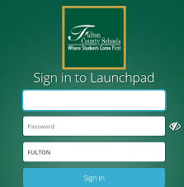
Online Resources
IReady for reading and math
Launchpad

Slide 27
Parent Conferences
Please sign up for a conference time before leaving today. It is located on the table by the window.
If your child goes to another teacher, the teacher will pass any information on to the homeroom teacher. They will ensure the homeroom teacher has this information prior to your conference.

Slide 28
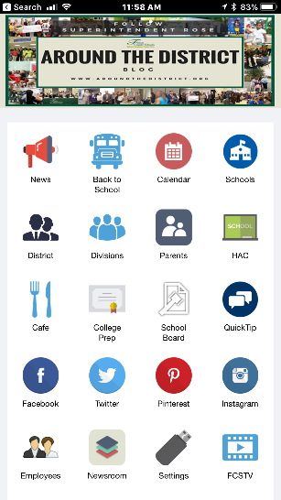
QuickTip!
How to use QuickTip
Install the Fulton County Schools App in Android or Apple Device
Select the “QuickTip” icon on the App.
You will see a form to choose your school and enter your message or “tip.”
Click “submit”
Safety & Security will receive the message immediately and begin working with schools and departments to verify and resolve reported issues.
Contact information is optional.
See an issue? Report it! Let’s work together to keep our schools safe.

Slide 29
Questions and Important Websites
Thank you so much for coming!! ☺
Please sign up for a conference before you leave!

